Slide 1
Final Project
Data Visualization
BA-54050-004
Professor Shahla Asadi
May 8, 2025
Group 4
Bhavya Jeevani Thandu
Sairam Jammu
Eric Draper

Slide 2
Overview
Problem Statement
Data Exploration & Cleansing
Sales & Product Questions
Dashboards
Additional Observations
Final Thoughts

Slide 3
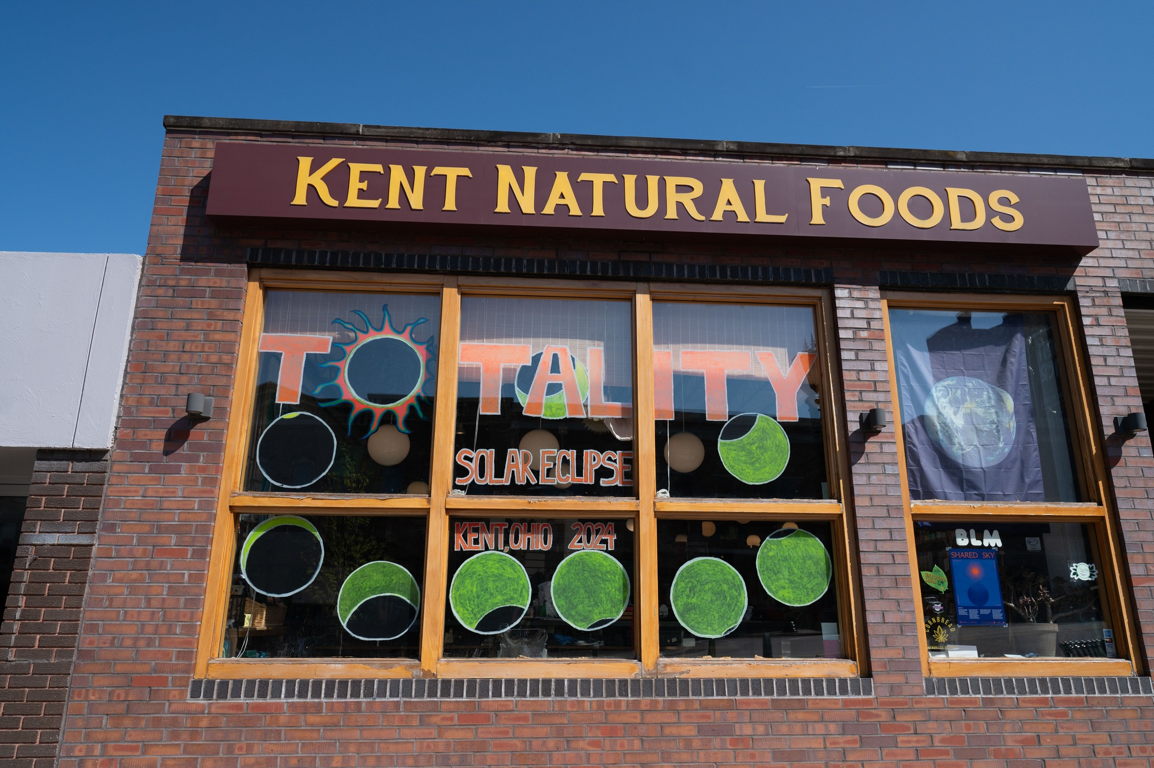
Overview
Kent Natural Food Store (KNFS) is a Co-Op that serves the community as a full-service grocery, offering fresh produce, bulk foods, packaged and refrigerated products, natural health and beauty products, vitamins and herbal supplements. They primarily carry local and organic items, and specialize in products without artificial ingredients, toxic chemicals or products tested on animals. Essentially, they provide safe, non-toxic and environmentally friendly products.

Slide 4
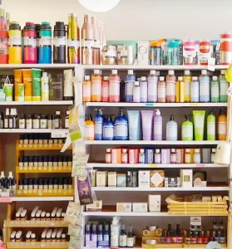

Problem Statement
Given existing data provided, how can operations and sales be improved at the store?
ordered, when they should order, or how much they should order. Further, KNFS has no clear insight into how it should manage its operations to improve efficiency and effectiveness in fulfilling its mission of serving the local community.
One of the first issues facing KNFS is to have a better sense of the current store operations. Specifically, the seven buyers would like to have clarity on some of the following:

Slide 5


Data Exploration and Cleansing
After loading the provided datasets, we visually inspected them.
We observed:
Data sets were not normalized, so defining table relationships would be difficult and require several additional hours of work.
Several values were missing --- List tables and columns?
We cleansed and prepared data as follows:
blah
Blah
Define Metrics, added a column

Slide 6
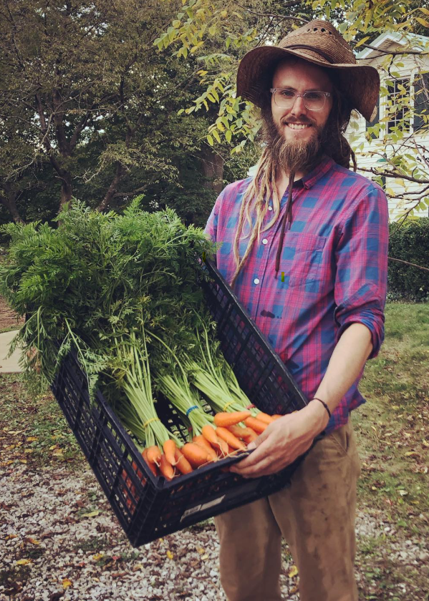
Sales and Products Questions
• Which items are selling the most?
• Which items are selling the least? Or answer Lowest Sales by Department
• How much inventory do we have? By item quantity and cost.
• Are there items we should order soon? How much?
• Which items have been in inventory the longest? Especially important for perishables.
• What are the total sales? What are the related costs of goods sold?
• Which department generates the most sales?
• What are the Total Sales for the store? What about Total Cost?

Slide 7
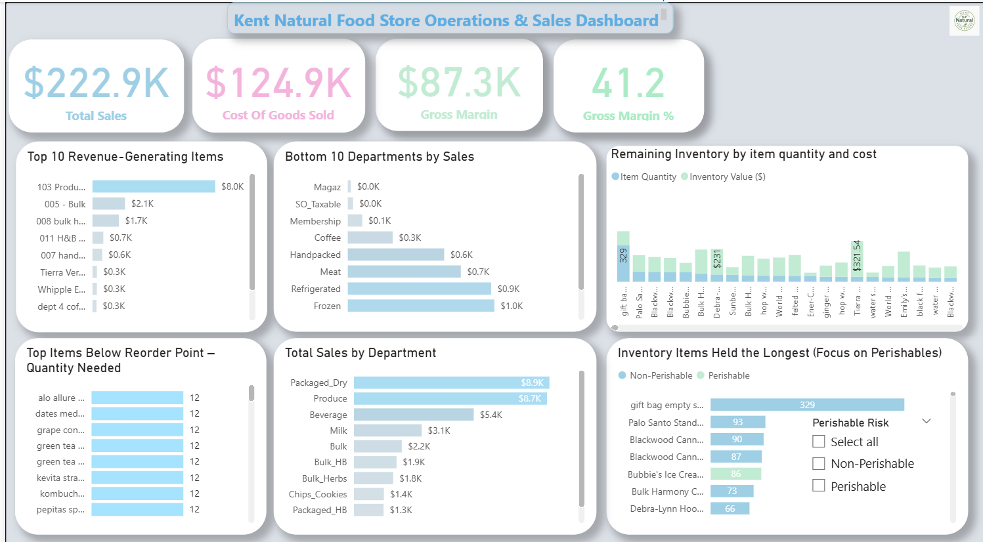
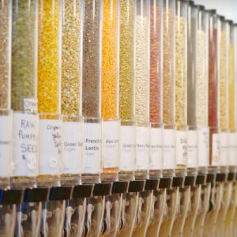
Dashboards

Slide 8
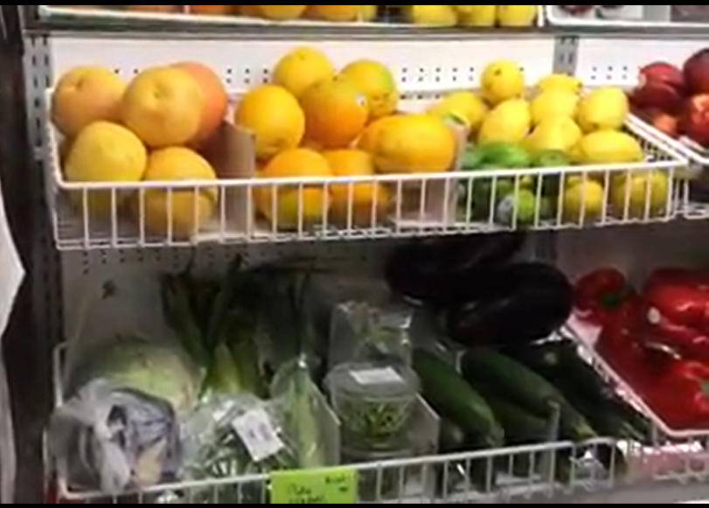
Dashboards

Slide 9
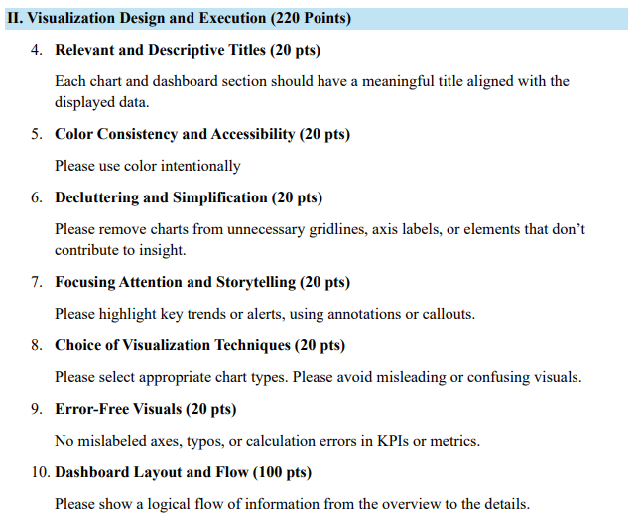

Slide 10
